Slide 1
Chapter 13. Data Encoding
Winter Textbook Seminar – Practical Malware Analysis
Presenter: Kyungbin Ryu
2026. 02. 04

Slide 2
Goal of Analyzing Encoding Algorithms
What is Encoding?
A reversible transformation of data into another representation for safe storage, transmission, or processing
Encoding for Malware …
Hide malicious activities and disguise its internal workings
Hide configuration information
Save information to a staging file before stealing it
Store strings used by the malware
Disguise the malware as a legitimate tool

Slide 3
Goal of Analyzing Encoding Algorithms
What is Encoding?
A reversible transformation of data into another representation for safe storage, transmission, or processing
Encoding for Malware …
Hide malicious activities and disguise its internal workings
Hide configuration information
Save information to a staging file before stealing it
Store strings used by the malware
Disguise the malware as a legitimate tool
Identify the encoding functions and then use that knowledge to decode the attacker’s secrets

Slide 4
Simple Ciphers
Encoding
Simple Ciphers
Caesar Cipher
XOR
Base64
Advantages of Simple Ciphers for Malware
Small enough to be used in space-constrained environments
Less obvious than more complex ciphers
Low overhead and thus little impact on performance
Examples
(1) Caesar Cipher
(2) XOR
(3) Base64

Slide 5
Simple Ciphers – (1) Caesar Cipher
Shift the letters of the alphabet k characters (k is an arbitrary number; usually known as k = 3)
AT TACK AT NOON
DWWDFN DW QRRQ
ABCDEFGHIJKLMNOPQRSTUVWXYZ
DEFGHIJKLMNOPQRSTUVWXYZABC

Slide 6
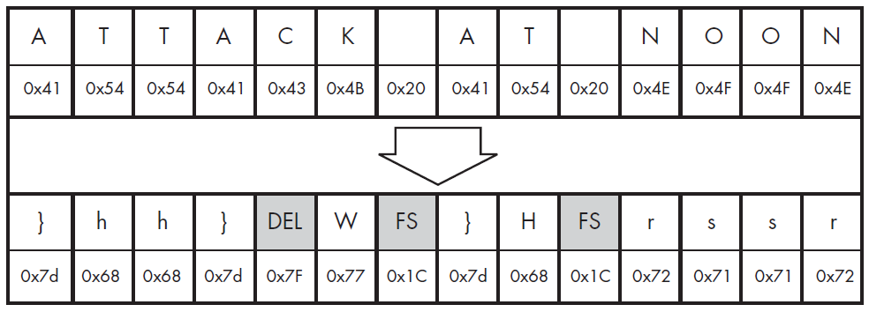
Simple Ciphers – (2) XOR
Use a static byte value (e.g., 0x3C)
Not limited to printable characters
Requires only a single machine-code instruction and supports reversibility
0x3C

Slide 7
Simple Ciphers – (2) XOR
Use a static byte value (e.g., 0x3C)
Not limited to printable characters
Requires only a single machine-code instruction and supports reversibility
0x41 = 0100 0001 “A”
0x3C = 0011 1100 (Key)
0x7D = 0111 1101 “}”
0x3C

Slide 8
Simple Ciphers – (2) XOR
Use a static byte value (e.g., 0x3C)
Not limited to printable characters
Requires only a single machine-code instruction and supports reversibility
0x41 = 0100 0001 “A”
0x3C = 0011 1100 (Key)
0x7D = 0111 1101 “}”
0x3C

Slide 9
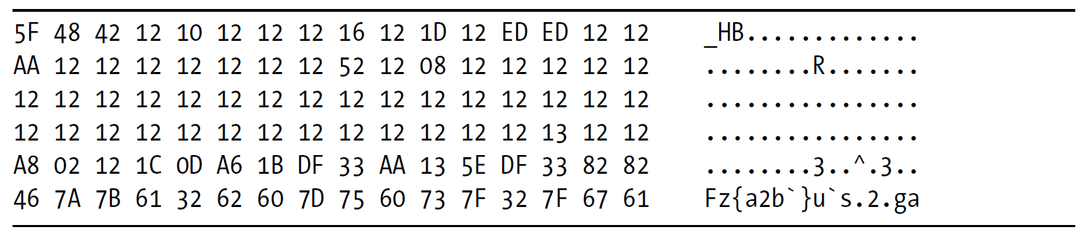
Simple Ciphers – (2) XOR
Scenario: Investigating a GIF file used by malware
The file should start with "GIF87a" or "GIF89a", but …

Slide 10
Simple Ciphers – (2) XOR
Scenario: Investigating a GIF file used by malware
The file should start with "GIF87a" or "GIF89a", but …
This file may be an XOR-encoded executable, but how do we find out?

Slide 11
Simple Ciphers – (2) XOR
Brute-Forcing XOR Encoding
Scenario: Investigating a GIF file used by malware
The file should start with "GIF87a" or "GIF89a", but …
This file may be an XOR-encoded executable, but how do we find out?
Brute Force!

Slide 12
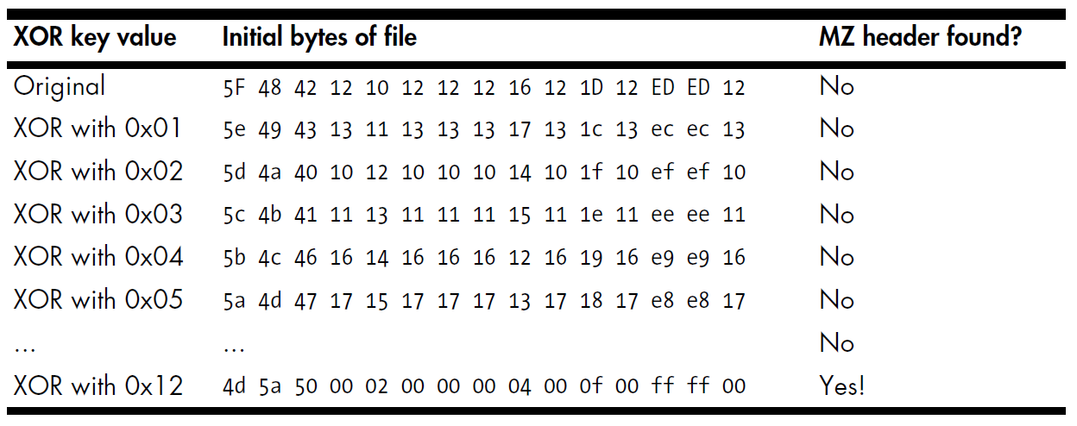
Simple Ciphers – (2) XOR
Brute-Forcing XOR Encoding
Try all 255 possible single-byte keys on the file header
Compare the output with the expected executable file header

Slide 13
Simple Ciphers – (2) XOR
Brute-Forcing XOR Encoding
Try all 255 possible single-byte keys on the file header
Compare the output with the expected executable file header
The key is 0x12!
PE files begin with the letters “MZ”
* PE file: The standard binary format used by Windows for executables

Slide 14
Simple Ciphers – (2) XOR
If the encoded content has many NULL bytes, the single-byte key becomes obvious

Slide 15
Simple Ciphers – (2) XOR
NULL-Preserving Single-Byte XOR Encoding
If the encoded content has many NULL bytes, the single-byte key becomes obvious
0x12?

Slide 16
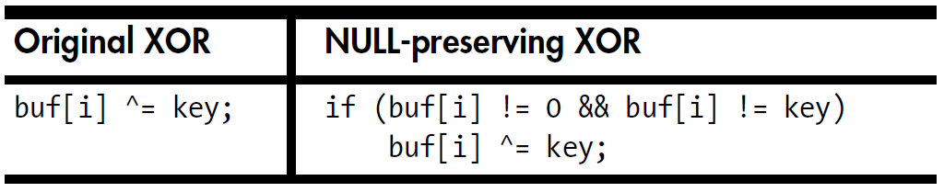
Simple Ciphers – (2) XOR
NULL-Preserving Single-Byte XOR Encoding
If the encoded content has many NULL bytes, the single-byte key becomes obvious
0x12?

Slide 17
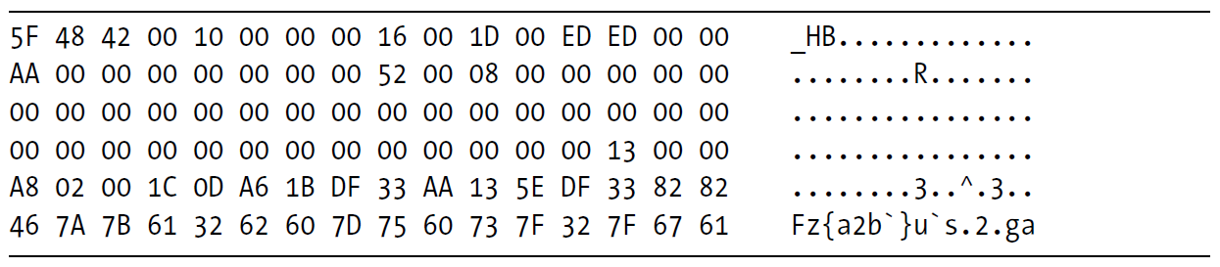
Simple Ciphers – (2) XOR
NULL-Preserving Single-Byte XOR Encoding
If the encoded content has many NULL bytes, the single-byte key becomes obvious
0x12?
???

Slide 18
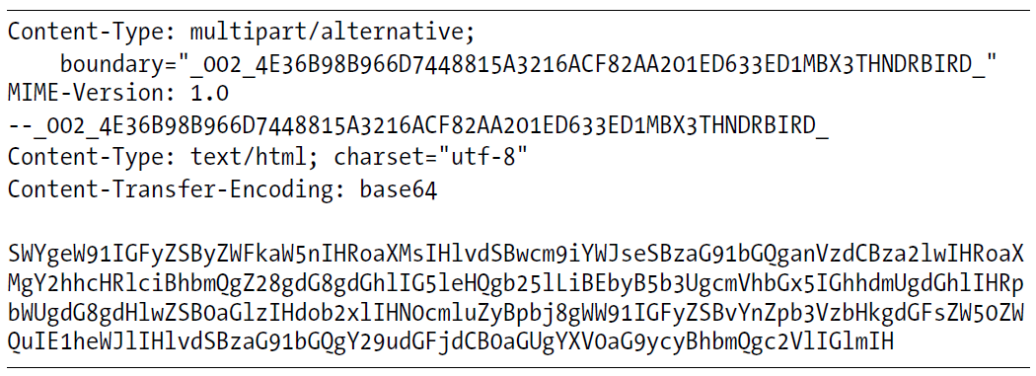
Simple Ciphers – (3) Base64
Converts binary data into a limited set of 64 ASCII characters
Multipurpose Internet Mail Extensions (MIME) Base64
A–Z, a–z, 0–9, +, / (64)
Example: Base64-encoded MIME email content

Slide 19
Simple Ciphers – (3) Base64
Converts binary data into a limited set of 64 ASCII characters
Multipurpose Internet Mail Extensions (MIME) Base64
A–Z, a–z, 0–9, +, / (64)
Example: Base64-encoded MIME email content
If you are reading this, you probably should just skip this chapter and go to the next one. Do you really have the time to type this whole string in? You are obviously talented. Maybe you should contact the authors and see if …
만약 네가 이걸 읽고 있다면, 아마 이 챕터는 그냥 건너뛰고 다음 챕터로 가는 게 좋을 거야. 진짜로 이 긴 문자열을 전부 입력할 시간이 있는 거야? 너는 분명히 재능이 있어 보이네. 어쩌면 저자들에게 연락해서 …

Slide 20
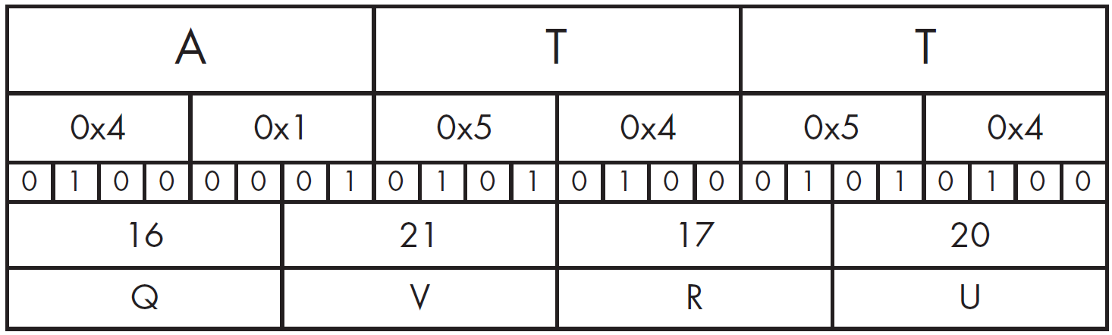
Simple Ciphers – (3) Base64
Transforming Data to Base64

Slide 21
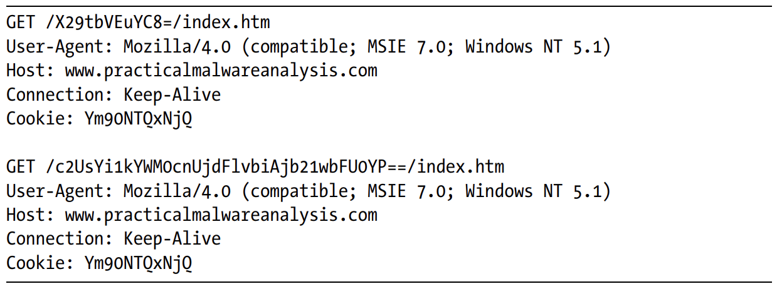
Simple Ciphers – (3) Base64
Identifying and Decoding Base64
The character set consists of alphanumeric characters plus two additional characters
A padding character (=) may appear at the end of an encoded string (if padded, its length is divisible by four)
Notes:
it’s easy to identify Base64-encoded content
While the Cookie value appears to remain constant, it looks like the attacker is sending two different encoded messages in the two GET requests.

Slide 22

Simple Ciphers – (3) Base64
Identifying and Decoding Base64
The character set consists of alphanumeric characters plus two additional characters
A padding character (=) may appear at the end of an encoded string (if padded, its length is divisible by four)
The attacker appears to track bots by assigning identification numbers and Base64-encoding them into a cookie
Notes:
it’s easy to identify Base64-encoded content
While the Cookie value appears to remain constant, it looks like the attacker is sending two different encoded messages in the two GET requests.

Slide 23
Simple Ciphers – (3) Base64
Finding the Base64 Function in the Malware
Base64 encoding is often identifiable by the presence of a 64-character indexing string in the code
Look for the 64-character string typically used to implement the algorithm

Slide 24
Simple Ciphers – (3) Base64
Finding the Base64 Function in the Malware
Base64 encoding is often identifiable by the presence of a 64-character indexing string in the code
Look for the 64-character string typically used to implement the algorithm
MIME Base64 standard:

Slide 25
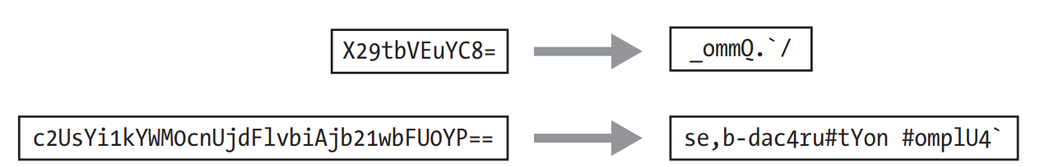
Simple Ciphers – (3) Base64
Finding the Base64 Function in the Malware
Base64 encoding is often identifiable by the presence of a 64-character indexing string in the code
Look for the 64-character string typically used to implement the algorithm
MIME Base64 standard:
This is NOT standard Base64 encoding!

Slide 26
Simple Ciphers – (3) Base64
A Simple Way to Create a New Indexing String
Relocate some of the characters to the front of the string

Slide 27
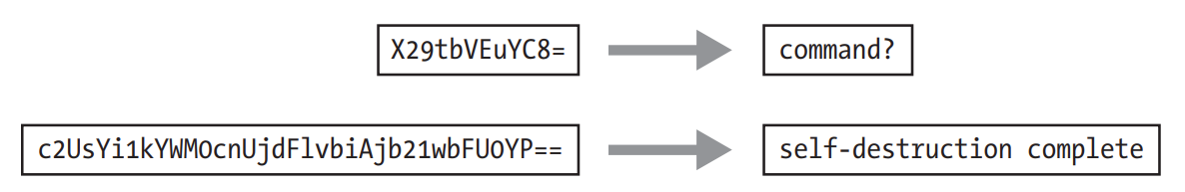
Simple Ciphers – (3) Base64
A Simple Way to Create a New Indexing String
Relocate some of the characters to the front of the string
Success!
The malware used a custom substitution cipher in its GET requests

Slide 28
Standard Cryptography
Encoding
Simple Ciphers
Standard Cryptography
Caesar Cipher
XOR
Base64
Malware often prefers simple ciphers because they are easy to implement and usually sufficient
Several Drawbacks using Standard Cryptographic Libraries
Cryptographic libraries can be large and increase the malware footprint
Static linking or reliance on host libraries may reduce portability
Standard cryptographic functions are easily detected (via imports, function signatures, or known constants)
Malware using symmetric encryption must also hide the encryption key
Many standard cryptographic algorithms rely on a strong secret key
Effective analysis requires identifying not only the algorithm, but also the encryption key

Slide 29
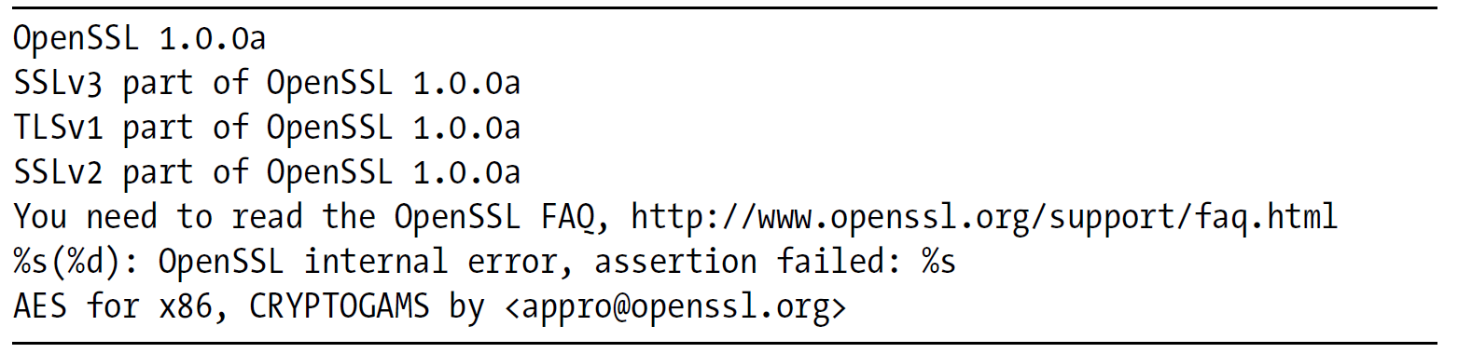
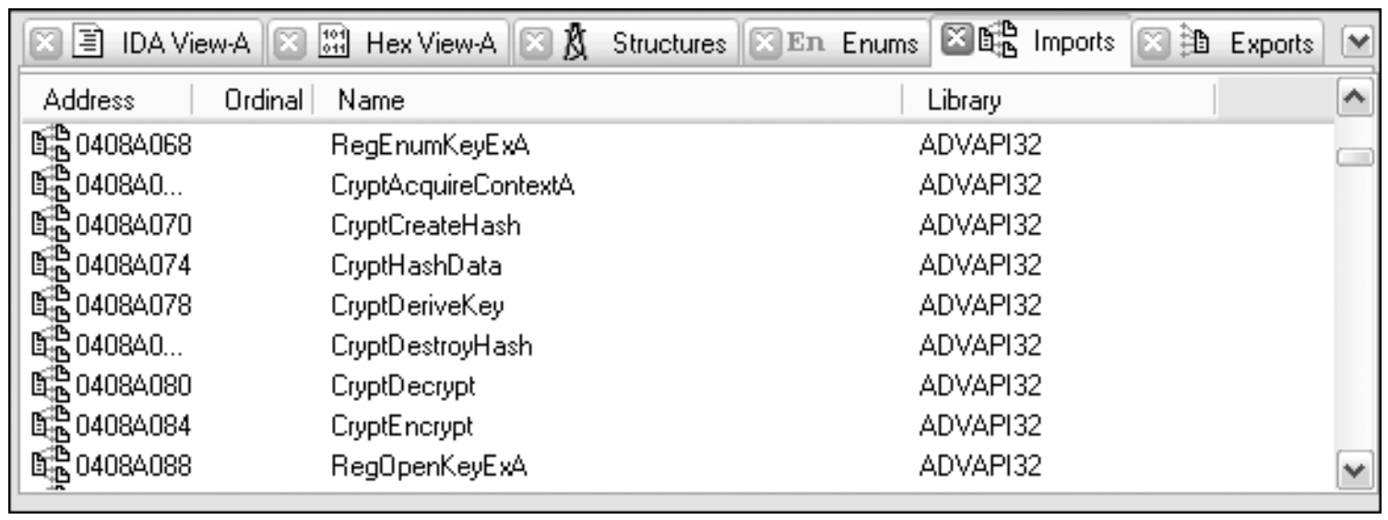
Identifying Standard Cryptography
1. Recognizing Strings and Imports
Identify strings that indicate the use of cryptography
Identify imported cryptographic libraries or functions

Slide 30
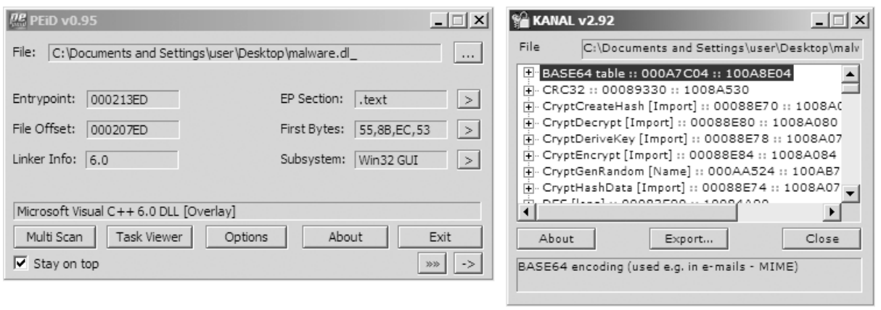
Identifying Standard Cryptography
2. Searching for Cryptographic Constants
Search for commonly used cryptographic constants
Tools such as IDA Pro FindCrypt2 and PEiD Krypto ANALyzer

Slide 31
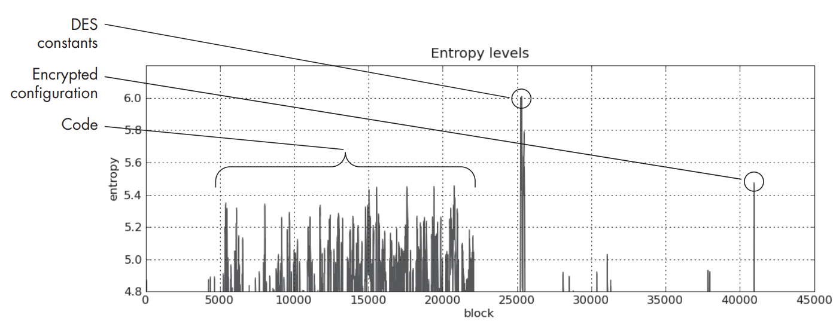
Identifying Standard Cryptography
3. Searching for High-Entropy Content
Identify high-entropy regions indicating encrypted data or keys
Useful when cryptographic constants are not present (e.g., RC4)
Notes:
고엔트로피 콘텐츠 기법은 다소 투박하며 최후의 수단으로 사용하는 것이 가장 좋습니다. 사진, 동영상, 오디오 파일 및 기타 압축 데이터와 같은 많은 유형의 콘텐츠는 높은 엔트로피를 나타내며 헤더를 제외하고는 암호화된 콘텐츠와 구별할 수 없습니다.

Slide 32
Custom Encoding
Encoding
Simple Ciphers
Standard Cryptography
Custom Encoding
Caesar Cipher
XOR
Base64
Approaches
Layer multiple simple encoding methods
E.g., perform one round of XOR encryption, followed by Base64 encoding
Develop a custom algorithm, possibly with similarities to a standard cryptographic algorithm

Slide 33
Custom Encoding
Encoding
Simple Ciphers
Standard Cryptography
Custom Encoding
Caesar Cipher
XOR
Base64
Approaches
Layer multiple simple encoding methods
E.g., perform one round of XOR encryption, followed by Base64 encoding
Develop a custom algorithm, possibly with similarities to a standard cryptographic algorithm
If there are no obvious signs, the job becomes more difficult

Slide 34
Identifying Custom Encoding
If outputs are suspected of containing encoded data, the encoding function will occur prior to the output
Conversely, decoding will occur after an input
In our example, the output is the encrypted files in the same directory as the malware
Trace the thread of execution from the suspicious input or output

Slide 35
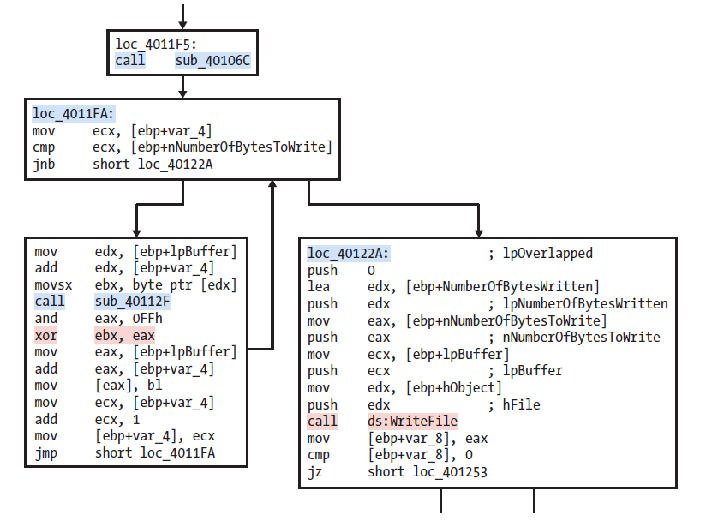
Identifying Custom Encoding
sub_4011A9
CreateFileA and WriteFile in imports

Slide 36
Advantages of Custom Encoding
Retain the simplicity of simple encodings while increasing reverse-engineering difficulty
Custom encoding allows attackers to define arbitrary schemes, with or without explicit keys
Even if a key is found, freely available libraries are unlikely to assist with decryption
Notes:
the characteristics of simple encoding schemes : (작은 크기와 암호화 방식의 모호성)

Slide 37
Decoding
Encoding
Decoding
Simple Ciphers
Standard Cryptography
Custom Encoding
Self-decoding
Manual Programming
Caesar Cipher
XOR
Base64
Malware Decoding Approaches
Self-Decoding
Use the decoding functions already present in the malware
Manual Programming
Reimplement the decoding functions

Slide 38
Decoding – (1) Self-Decoding
Let the program itself perform the decryption during its normal activities

Slide 39
Decoding – (1) Self-Decoding
Drawbacks
Requires isolating decryption routines and setting precise breakpoints
→ Labor-intensive and easy to miss
If the malware does not decrypt the target data …
→ No useful results
Let the program itself perform the decryption during its normal activities

Slide 40
Decoding – (1) Self-Decoding
Drawbacks
Requires isolating decryption routines and setting precise breakpoints
→ Labor-intensive and easy to miss
If the malware does not decrypt the target data …
→ No useful results
Important to use techniques that provide more control !
Let the program itself perform the decryption during its normal activities

Slide 41
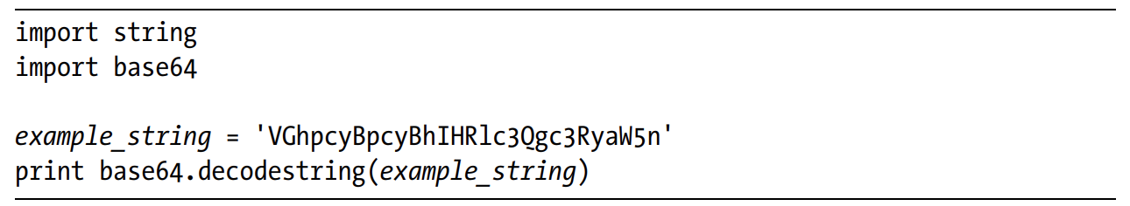
Decoding – (2) Manual Programming
1. Simple Encoding Methods
Use the standard functions

Slide 42
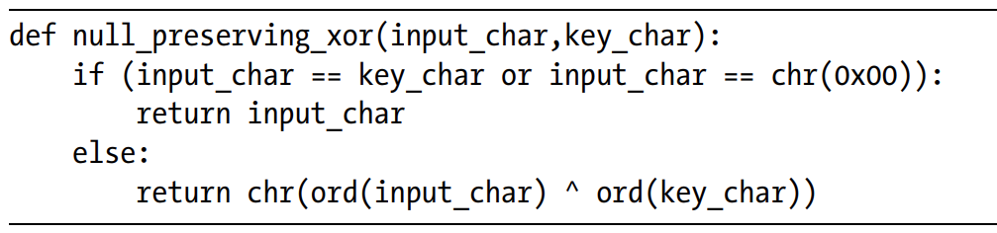
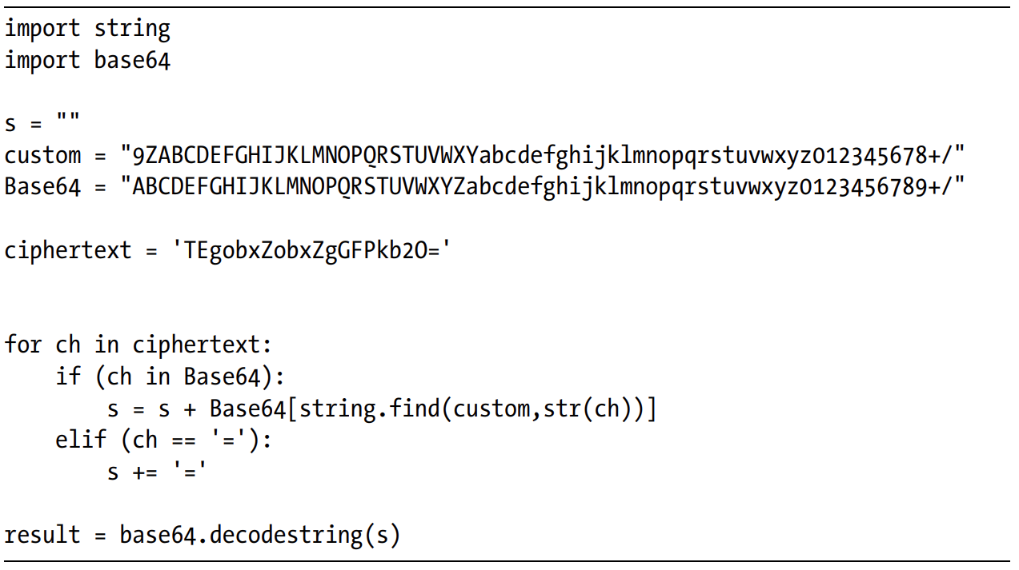
Decoding – (2) Manual Programming
2. Simple Encoding Methods that Lack Standard Functions
Program the encoding function
Example_1:
Example_2:
Notes:
1: An example of a Python function that implements a NULL-preserving XOR encoding 2: A small Python script that translates the custom Base64 characters to the standard Base64 characters, and then uses the standard function that is part of the Python base64 library decodestring

Slide 43
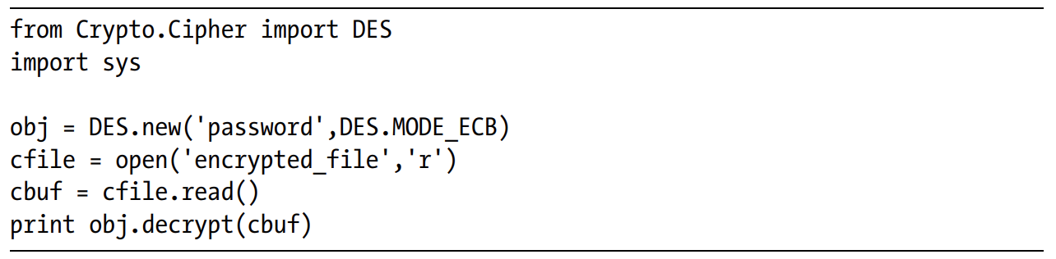
Decoding – (2) Manual Programming
3. Standard Cryptographic Algorithms
Use existing implementations that are available in code libraries

Slide 44
Decoding – (2) Manual Programming
3. Standard Cryptographic Algorithms
Use existing implementations that are available in code libraries
What if Cryptography is too COMPLEX …?

Slide 45
Decoding – (3) Using Instrumentation
A debugger allows the analyst to directly control the program’s execution flow
Instead of reimplementing the encryption algorithm, the malware itself is repurposed as a decryption tool
Encrypted data is provided as input, and the same routine used for encryption is re-executed to perform decryption
Considerations
Not all encoding or encryption routines are self-contained
Some cryptographic routines require a key
The key may be embedded within the malware or obtained from an external source (e.g., a network server)
In such cases, the analyst may need to:
Recreate the normal execution environment
Reimplement the key derivation or initialization logic
Simulate a server that provides the encryption key

Slide 46
Keywords
Encoding
Decoding
Simple Ciphers
Standard Cryptography
Custom Encoding
Self-decoding
Manual Programming
Using Instrumentation
Caesar Cipher
XOR
Base64

Slide 47
Lab13_01
Compare the strings in the malware (from the output of the strings command) with the information available via dynamic analysis. Based on this comparison, which elements might be encoded?
Use IDA Pro to look for potential encoding by searching for the string xor. What type of encoding do you find?
What is the key used for encoding and what content does it encode?
Use the static tools FindCrypt2, Krypto ANALyzer (KANAL), and the IDA Entropy Plugin to identify any other encoding mechanisms. What do you find?
What type of encoding is used for a portion of the network traffic sent by the malware?
Where is the Base64 function in the disassembly?
What is the maximum length of the Base64-encoded data that is sent? What is encoded?
In this malware, would you ever see the padding characters (= or ==) in the Base64-encoded data?
What does this malware do?

Slide 48
Lab13_01
1. Compare the strings in the malware (from the output of the strings command) with the information available via dynamic analysis. Based on this comparison, which elements might be encoded?
Static Analysis:
Use the strings command (Extracts human-readable strings from the executable without executing it)
Observed Strings:
User-Agent–like string: Mozilla/4.0
URL format string: http://%s/%s/
WinINet APIs:
InternetOpenUrlA
InternetReadFile
Presence of a Base64 alphabet: ABCDEFGHIJKLMNOPQRSTUVWXYZabcdefghijklmnopqrstuvwxyz0123456789+/

Slide 49
Lab13_01
1. Compare the strings in the malware (from the output of the strings command) with the information available via dynamic analysis. Based on this comparison, which elements might be encoded?
Dynamic Analysis:
Use Immunity Debugger
The actual domain or path is not visible in plaintext
Set breakpoints on network-related APIs:
bp InternetOpenUrlA
bp HttpSendRequestA
Observed Behavior:
http://www.practicalmalwareanalysis.com/a3l1bmdiaW4=
The malware is attempting to connect and the exact meaning of the GET path is not yet known

Slide 50
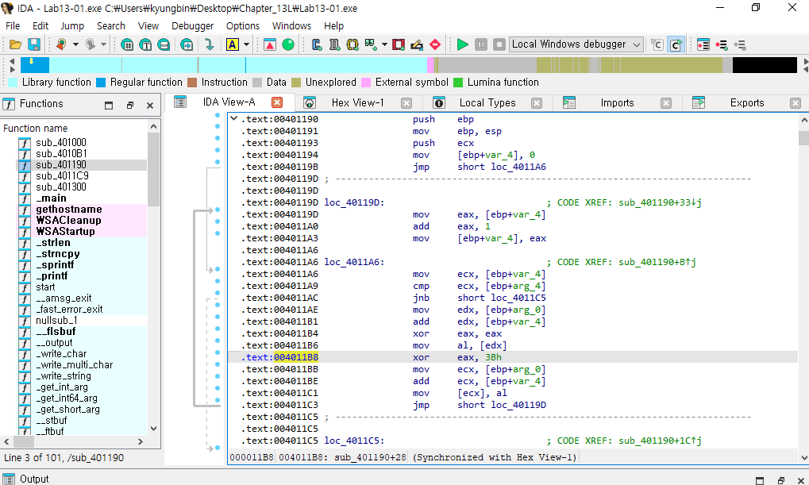
Lab13_01
2. Use IDA Pro to look for potential encoding by searching for the string xor. What type of encoding do you find?
A single-byte XOR encoding/decoding loop was identified in sub_401190
1 byte
Repeat

Slide 51

Lab13_01
3. What is the key used for encoding and what content does it encode?
Key: 0x3B

Slide 52
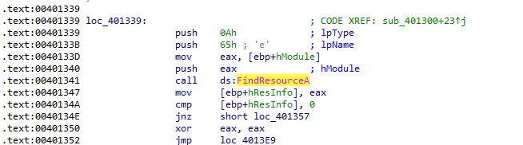
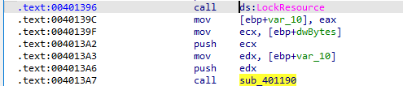
Lab13_01
3. What is the key used for encoding and what content does it encode?
Key: 0x3B
The call to sub_401190 is preceded by a call to LockResource
* LockResource is a Windows API used to access data stored in the .rsrc section
This indicates that the encoded data is stored as an internal resource
The return value of LockResource is passed to sub_401190 as input
sub_401190 applies XOR decoding to this resource data

Slide 53
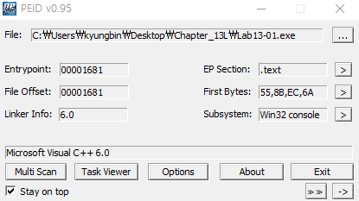
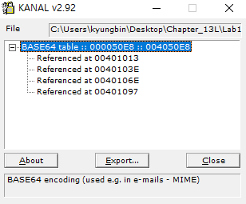
Lab13_01
4. Use the static tools FindCrypt2, Krypto ANALyzer (KANAL), and the IDA Entropy Plugin to identify any other encoding mechanisms. What do you find?
Used PEiD’s Krypto ANALyzer

Slide 54
Lab13_01
5. What type of encoding is used for a portion of the network traffic sent by the malware?
Observed URL:
http://www.practicalmalwareanalysis.com/a3l1bmdiaW4=
Base64 encoding is used here
The encoded data is used to construct the GET request path

Slide 55
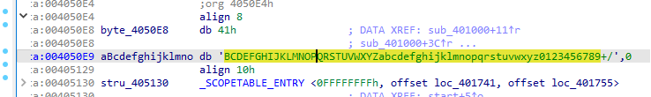
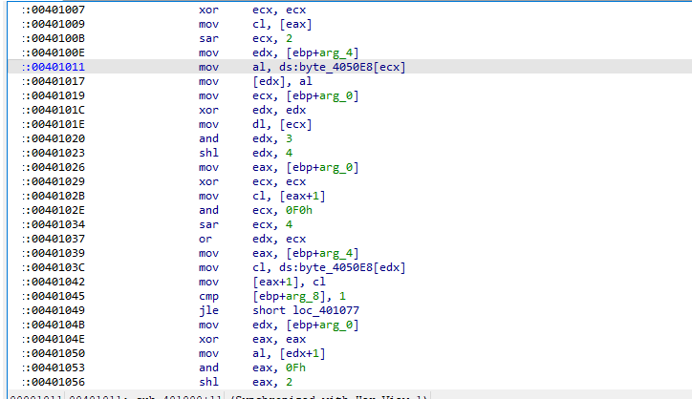
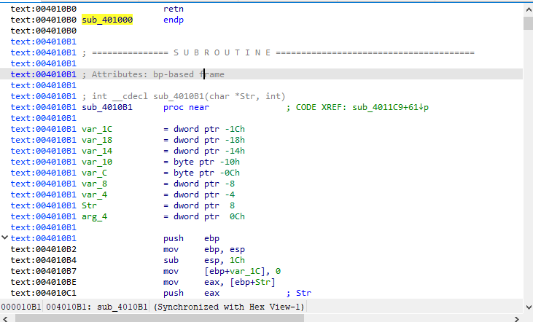
Lab13_01
6. Where is the Base64 function in the disassembly?
0x00401000
0x004010B1

Slide 56
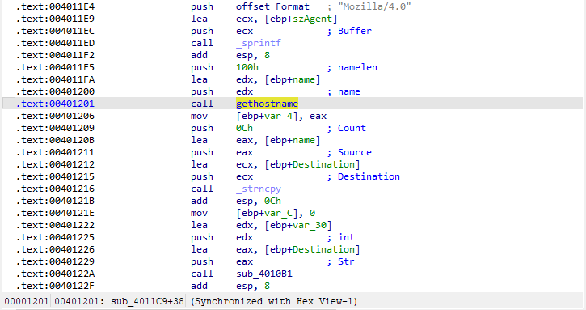
Lab13_01
7. What is the maximum length of the Base64-encoded data that is sent? What is encoded?
The code location calling gethostname was identified
The buffer used to receive the hostname has a size of 0x100 (256 bytes)
Only the first 12 bytes of the hostname are copied into the destination buffer
This destination buffer is passed as input to the Base64 encoding routine (sub_401000)
The malware encodes the first 12 bytes of the system hostname

Slide 57
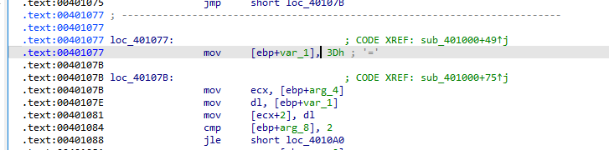
Lab13_01
8. In this malware, would you ever see the padding characters (= or ==) in the Base64-encoded data?

Slide 58
Lab13_01
9. What does this malware do?
Behavior
This malware collects the hostname of the infected system
It encodes the hostname using Base64
The encoded data is transmitted to a remote server via an HTTP GET request
Purpose
Allows the attacker to identify infected systems
Enables monitoring and tracking of compromised hosts

Slide 59
Thank you

